Slide 1
Course Name : Databases
A. Mohammed Khalifa
Karary University, Sep2022
Course main Book : FUNDAMENTALS OF DATABASE SYSTEMS , Ramez Elmasri and Shamkant B. Navathe, sixth edition, 2012

Slide 2
Course Contents
1 Databases and Database Users , Ch(1).
2. Database System Concepts and Architecture, Ch(2) .
3 The Relational Data Model and Relational Database Constraints, Ch(3) .
4 Basic SQL, Ch(4)(Lab).
5 The Relational Algebra and Relational Calculus, Ch(6)(Seminar).
6 Data Modeling Using the Entity-Relationship (ER) Model Ch(7).
7 Basics of Functional Dependencies and Normalization for Relational Databases Ch(15).

Slide 3
Course Evaluation
Attendance 10%
Mid Term Exam 10%
Seminar 10%
Lab and Lab Exams 20%
Final Exam 50%

Slide 4
Chapter 1
Databases and Database Users
A. Mohammed Khalifa
Karary University, Sep2022
Original Slides from Fundamental of Database Systems Book

Slide 5
Chapter 1 Outline
Types of Databases and Database Applications
Basic Definitions
Typical DBMS Functionality
Example of a Database (UNIVERSITY)
Main Characteristics of the Database Approach
Types of Database Users
Advantages of Using the Database Approach
When Not to Use Databases

Slide 6
Types of Databases and Database Applications

Slide 7
Types of Database Applications
Traditional Applications:
  Numeric and Textual Databases in Business Applications
More Recent Applications:
  Multimedia Databases (images, videos, voice, etc.)
  Geographic Information Systems (GIS)
  Data Warehouses
  Real-time and Active Databases
  Many other applications

Slide 8
Basic Definitions

Slide 9
Basic Definitions
Database:
  A collection of related data.
Data:
  Known facts that can be recorded and have an implicit meaning.
Mini-world:
  Some part of the real world about which data is stored in a database. For example, student registration, grades and transcripts at a university.
Database Management System (DBMS):
  A software package/system to facilitate the creation and maintenance of a computerized database.
Database System:
  The DBMS software together with the data itself. Sometimes, the application programs and interfaces are also included.

Slide 10

Simplified database system environment
(Figure 1.1)

Slide 11
Typical DBMS Functionality

Slide 12
Typical DBMS Functionality
Define a particular database in terms of its data types, structures, and constraints
Construct or Load the initial database contents on a secondary storage medium (typically hard disk)
Manipulating the database:
  Retrieval: Querying, generating reports
  Modification: Insertions, deletions and updates to its content
  Accessing/changing the database through Web applications
Processing and Sharing by a set of concurrent users and application programs – yet, keeping all data valid and consistent

Slide 13
Typical DBMS Functionality (cont.)
Other features:
  Protection or Security measures to prevent unauthorized access
  “Active” processing to take internal actions on data
  Presentation and Visualization of data
  Maintaining the database and associated programs over the lifetime of the database application

Slide 14
Example of a Database (UNIVERSITY)

Slide 15
Example of a Database UNIVERSITY Application
Mini-world for the example:
  Part of a UNIVERSITY environment.
Some mini-world entities:
  STUDENTs
  COURSEs
  SECTIONs (of COURSEs)
  (academic) DEPARTMENTs
  INSTRUCTORs

Slide 16
Example of a Database UNIVERSITY Application (cont.)
Some mini-world relationships:
  SECTIONs are of specific COURSEs
  STUDENTs take SECTIONs
  COURSEs have prerequisite COURSEs
  INSTRUCTORs teach SECTIONs
  COURSEs are offered by DEPARTMENTs
  STUDENTs major in DEPARTMENTs
Note: The above entities and relationships are typically expressed in a conceptual data model, such as the ENTITY-RELATIONSHIP data model (see Chapters 7, 8)

Slide 17
Example of a Database UNIVERSITY Application (cont.)
The next two slides (Figure 1.2 from textbook) show what a simple UNIVERSITY database may look like

Slide 18
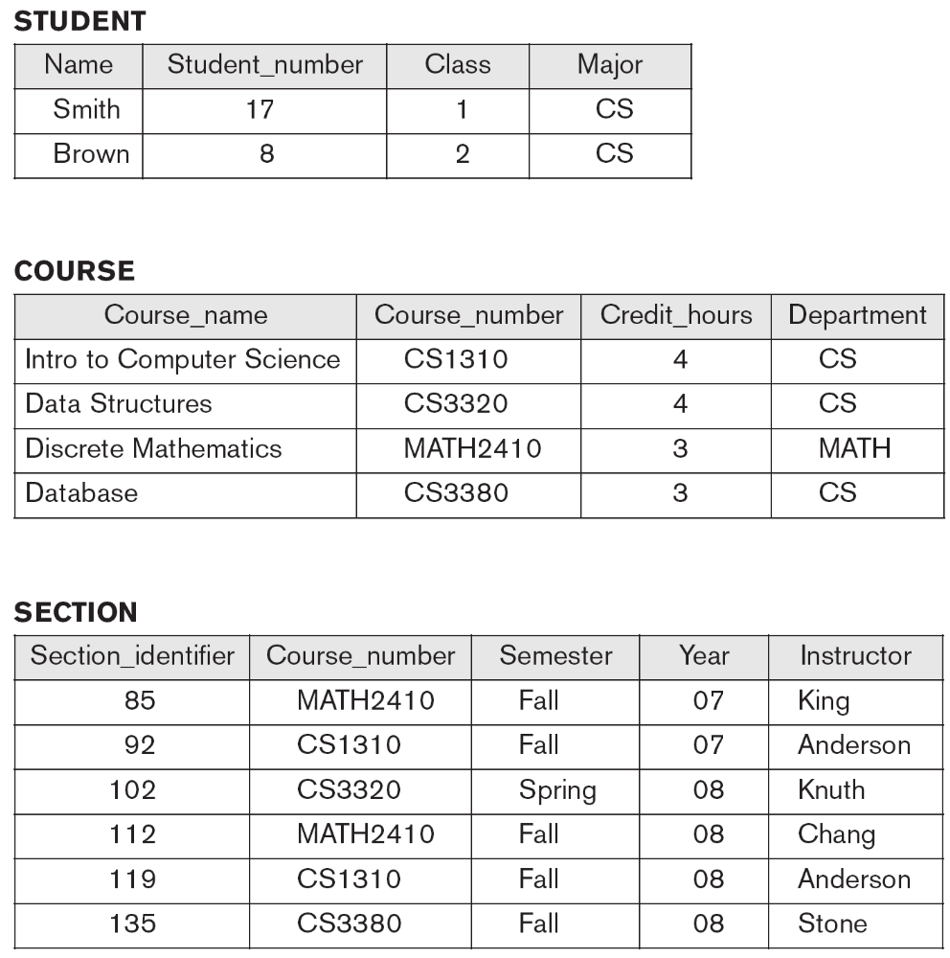
Continued next page…

Slide 19
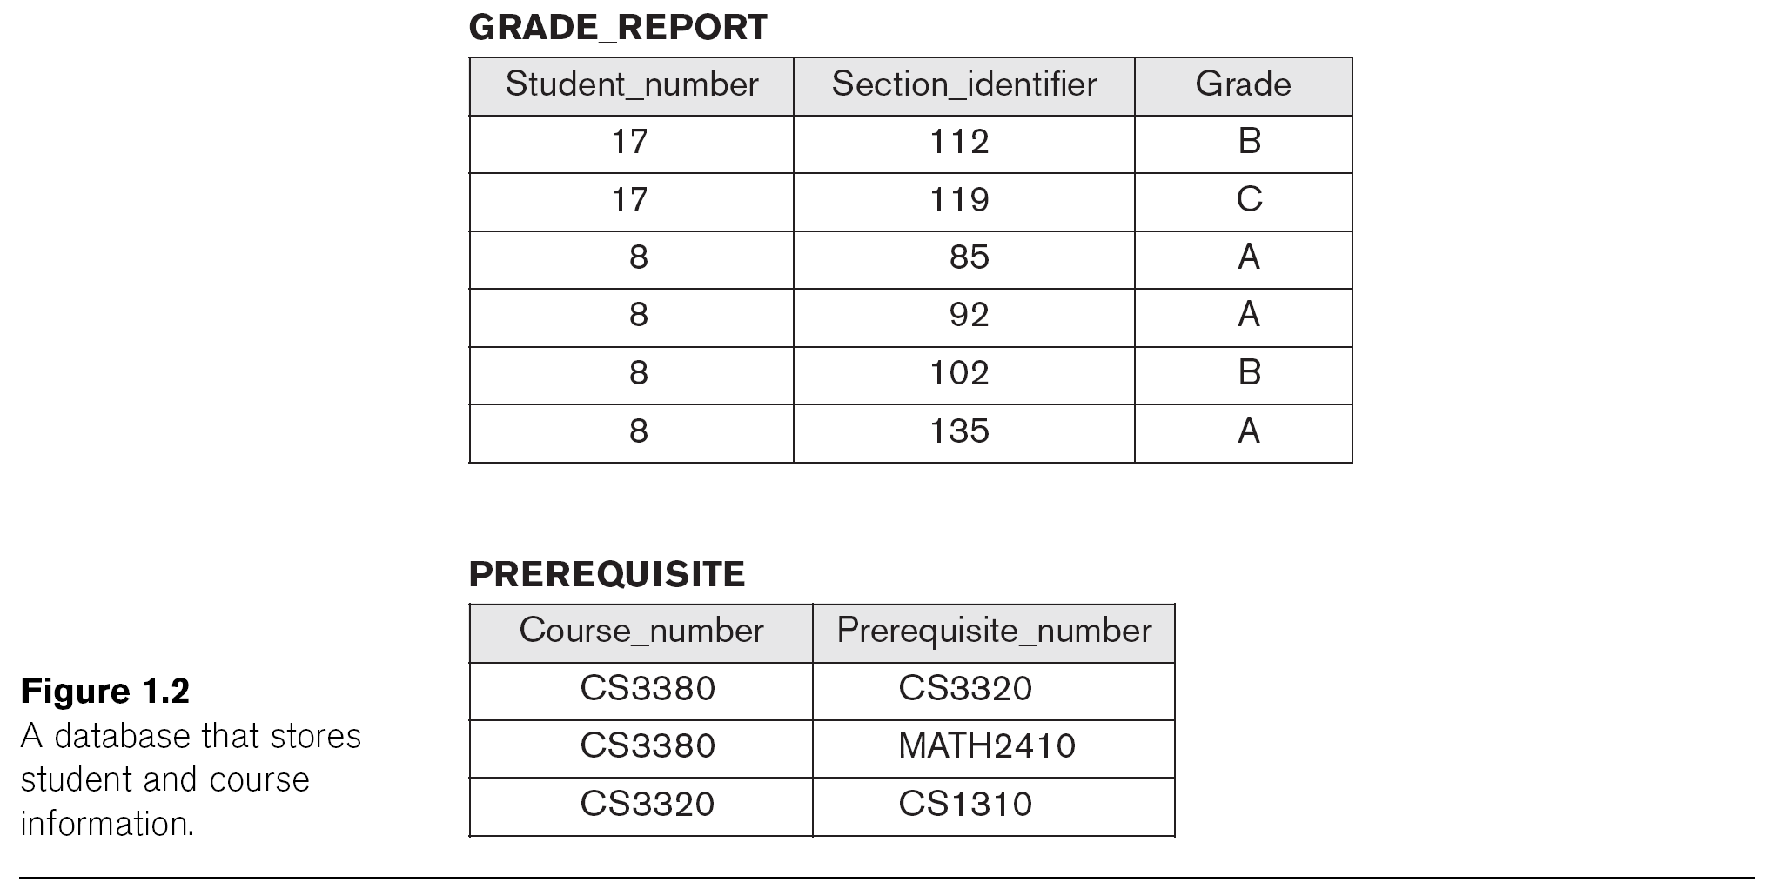

Slide 20
Main Characteristics of the Database Approach

Slide 21
Main Characteristics of the Database Approach
Self-describing nature of a database system:
  A DBMS catalog stores the description of a particular database (e.g. data structures, types, and constraints)
  The description is called meta-data (see next slide).
  This allows the DBMS software to work with different database applications (university, bank, airlines, etc.)
Insulation between programs and data:
  Called program-data independence.
  Allows changing data structures and data storage organization without having to change the DBMS access programs.

Slide 22

Example of meta-date in a simplified database catalog (Figure 1.3)

Slide 23
Main Characteristics of the Database Approach (cont.)
Insulation between programs and data (cont.):
  Accomplished through data abstraction
  A data model is used to hide storage details and present the users with a conceptual view of the database.
  Programs refer to the data model constructs rather than data storage details
Support of multiple views of the data:
  Each user may see a different view of the database, which describes only the data of interest to that user.

Slide 24
Main Characteristics of the Database Approach (cont.)
Sharing of data and multi-user transaction processing:
  Allowing a set of user transactions to access and update the database concurrently (at the same time).
  Concurrency control within the DBMS guarantees that each transaction is correctly executed or aborted
  Recovery subsystem ensures each completed transaction has its effect permanently recorded in the database
  OLTP (Online Transaction Processing) is a major part of database applications (allows hundreds of concurrent transactions to execute per second)

Slide 25
Types of Database Users

Slide 26
Types of Database Users
Users may be divided into
  Those who actually use and control the database content, and those who design, develop and maintain database applications (called “Actors on the Scene”), and
  Those who design and develop the DBMS software and related tools, and the computer systems operators (called “Workers Behind the Scene”).

Slide 27
Database Users: End-users
Actors on the scene
  End-users: Use the database for queries, reports, and updating the database content. Can be categorized into:
    Casual end-users: access database occasionally when needed
    Naïve (or Parametric) end-users: largest section of end-user population.
      Use previously implemented and tested programs (called “canned transactions”) to access/update the database.
      Examples are bank-tellers or hotel reservation clerks or sales clerks.

Slide 28
Database Users: End-users (cont)
    Sophisticated end-users:
      These include business analysts, scientists, engineers, others thoroughly familiar with the system capabilities.
      Many use tools in the form of software packages that work closely with the stored database.
    Stand-alone end-users:
      Mostly maintain personal databases using ready-to-use packaged applications.
      An example is a tax program user that creates its own internal database.
      Another example is a user that maintains an address book

Slide 29
Database Users: DB Administrators (DBAs) and Designers
Actors on the scene (continued)
  Database administrators:
    Responsible for authorizing/controlling access to the database; coordinating and monitoring its use; acquiring software and hardware resources; and monitoring efficiency of operations.
  Database Designers:
    Responsible for defining database structure, constraints, and transactions; communicate with users to understand their needs.

Slide 30
Advantages of Using the Database Approach

Slide 31
Advantages of Using the Database Approach
Controlling redundancy in data storage and in development and maintenance efforts.
  Sharing of data among multiple users.
Restricting unauthorized access to data.
Providing persistent storage for program Objects
Providing Storage Structures (e.g. indexes) for efficient Query Processing

Slide 32
Advantages of Using the Database Approach (cont.)
Providing backup and recovery services.
Providing multiple interfaces to different classes of users.
Representing complex relationships among data.
Enforcing integrity constraints on the database.
Drawing inferences and actions from the stored data using deductive and active rules
Allowing multiple “views” of the same data (see next slide, Figure 1.5 from textbook)

Slide 34
Additional Implications of Using the Database Approach
Potential for enforcing standards:
  Crucial for the success of database applications in large organizations. Standards refer to data item names, display formats, screens, report structures, meta-data (description of data), Web page layouts, etc.
Reduced application development time:
  The time neede to add each new application is reduced.

Slide 35
Additional Implications of Using the Database Approach (cont.)
Flexibility to change data storage structures:
  Storage structures may evolve to improve performance, or because of new requirements.
Availability of up-to-date information:
  Extremely important for on-line transaction systems such as airline, hotel, car reservations.
Economies of scale:
  Wasteful overlap of resources and personnel can be avoided by consolidating data and applications across departments.

Slide 36
Historical Development of Database Technology

Slide 37
Historical Development of Database Technology
Early Database Applications:
  The Hierarchical and Network Models were introduced in mid 1960s and dominated during the seventies.
  Some worldwide database processing still occurs using these models; particularly, the hierarchical model.
Relational Model based Systems:
  Relational model was introduced in 1970, and heavily researched and experimented with at IBM Research and several universities.
  Relational DBMS Products emerged in the early 1980s and now dominate the market.

Slide 38
Historical Development of Database Technology (cont.)
Object-oriented and emerging applications:
  Object Databases (ODBs) were introduced in late 1980s and early 1990s to cater to the need of complex data and applications, and the proliferation of object-oriented programming languages.
  Many relational DBMSs have incorporated object database concepts, leading to a new category called object-relational databases (ORDBs)
  Extended relational systems add further capabilities (e.g. for multimedia data, XML, spatial, and other data types)

Slide 39
When Not to Use Databases

Slide 40
When not to use a DBMS
Main inhibitors (costs) of using a DBMS:
  High initial investment and possible need for additional hardware.
  Overhead for providing generality, security, concurrency control, recovery, and other functions.
When a DBMS may be unnecessary:
  If the database and applications are simple, well defined, and not expected to change.
  If there are stringent real-time requirements that may not be met because of DBMS overhead.
  If access to data by multiple users is not required.

Slide 41
When not to use a DBMS (cont.)
When DBMS may not be suffice (be enough ):
  If the database system is not able to handle the complexity of data because of modeling limitations
  If the database users need special operations not supported by the DBMS
  When DBMS overhead makes it impossible to achieve the needed application performance

